Slide 1
PSCS200 - Billy - Buddy against cyber bullying
PIP2001 Capstone Project
Review-1
Batch Number: CBC06
Roll Number | Student Name
20211CBC0025 20211CBC0027 20211CBC0047 20211CBC0065 | A.V. Divakara Reddy Sanda Naveen Reddy M. Obulsubba Reddy Podamekala Sudheer
Under the Supervision of,
Ms. Arshiya Lubna
Assistant Professor,
School of Computer Science and Engineering
Presidency University
Name of the Program: CSE
Name of the HoD: Dr. Pravintha Raja
Name of the Program Project Coordinator: Suma Gowda N G
Name of the School Project Coordinators: Dr. Sampath A K / Dr. Abdul Khadar A / Mr. Md Ziaur Rahman

Slide 2
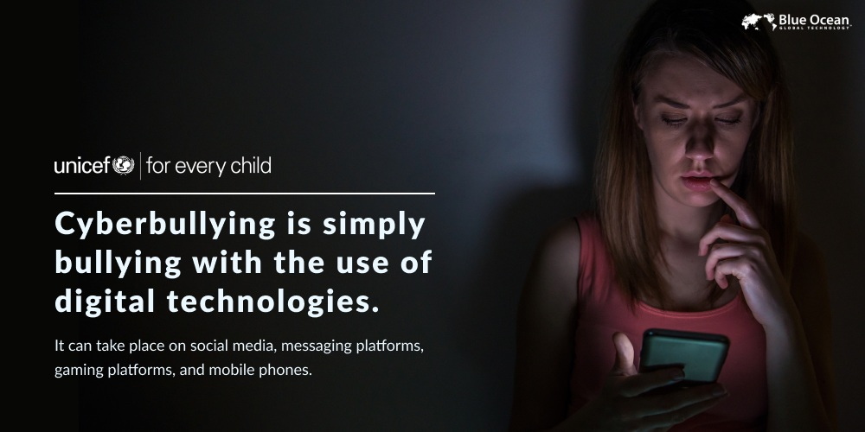
Introduction
Cyberbullying may be a relatively new phenomenon, but the increase in social media sites and the ever-growing use of digital devices provide a ripe environment for the proliferation of bullying tactics. Unfortunately, it is something we must learn to live with and defend ourselves from.
According to the global anti-bullying campaign by DoSomething.org, about 37% of young people between the ages of 12 and 17 have been bullied online, and 30% have experienced it more than once. And worryingly, young people who experience cyberbullying are at a greater risk for both self-harm and suicidal behavior.

Slide 3
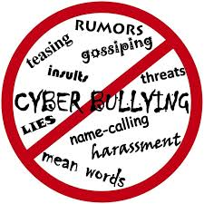
Literature Review
Cyberbullying has emerged as a significant social issue, particularly among adolescents, leading to psychological distress, anxiety, and depression. Research indicates that social media platforms serve as prime environments for such behavior, with anonymity fostering increased harassment. Numerous studies emphasize the need for proactive intervention and educational tools to mitigate the impacts of cyberbullying. Peer-support systems and AI-driven solutions are identified as promising methods for early detection and prevention

Slide 4
Existing method Drawback
Existing methods to combat cyberbullying, such as content filtering, manual reporting, and AI-based moderation, have notable drawbacks:
Manual reporting puts the burden on victims, who may hesitate due to fear of retaliation or shame.
AI moderation struggles with detecting sarcasm or implicit bullying, leading to both false positives and false negatives.
Lack of real-time support leaves victims feeling isolated, as responses are often delayed.
Lack of education for users on recognizing and addressing cyberbullying means existing methods miss opportunities for empowerment.
Lack of education for users on recognizing and addressing cyberbullying means existing methods miss opportunities for empowerment.

Slide 5
Proposed Method
User Registration: Users sign up with verified credentials to ensure accountability.
Monitoring Tools: Utilize AI-based algorithms to monitor online interactions for harmful language or bullying behavior.
Real-time Alerts: When harmful content is detected, notify both the victim and a trusted adult or authority figure.
Parental Dashboard: Offer a separate dashboard for parents to track their children's online safety and well-being.
Anonymity Protection: Safeguard victims' identities when they report incidents to protect them from further harm.
Community Support Groups: Create safe online spaces where victims can interact with others for emotional support and advice.

Slide 6
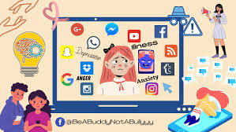
Objectives
To create a supportive, AI-powered platform that helps users report and address instances of cyberbullying.
To promote a safe online environment for teenagers and young adults by offering real-time interventions.
To provide resources and emotional support to victims of cyberbullying through trained professionals.
To collaborate with schools, parents, and community organizations to create anti-cyberbullying initiatives.
To measure the effectiveness of interventions and continually improve through user feedback.

Slide 7
Methodology/Modules
Research: Conduct comprehensive research on cyberbullying patterns, victims' demographics, and behavior to inform design.
User-Centered Design: Develop an intuitive interface focusing on ease of use, empathy, and accessibility for diverse users.
Testing and Iteration: Conduct usability testing with target audiences and iterate based on feedback to ensure effectiveness and reliability.
This methodology focuses on research, technology, collaboration, and user-centered design to create an impactful tool against cyberbullying.

Slide 8
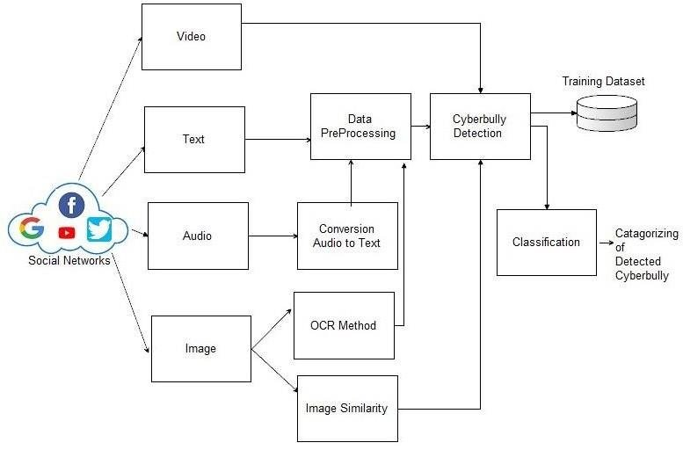
Architecture

Slide 9
software components
User Interface (UI)
Real-time Chat Monitoring
Incident Reporting Module
Support System Integration

Slide 10
Timeline of Project
Phase 1: Research & Planning (weeks 1-3 )
Identify the target audience.
Research cyberbullying statistics and trends.
Define project goals and outcomes.
Phase 2: Design & Conceptualization (Weeks 4-6)
Develop app concept and features.
Create wireframes and user journey.
Plan for content (educational materials, reporting features).
Phase 3: Development (weeks 6-10)
Build core features (e.g., user profiles, reporting system, chatbot).
Backend and database setup . Integrate security and privacy controls.

Slide 11
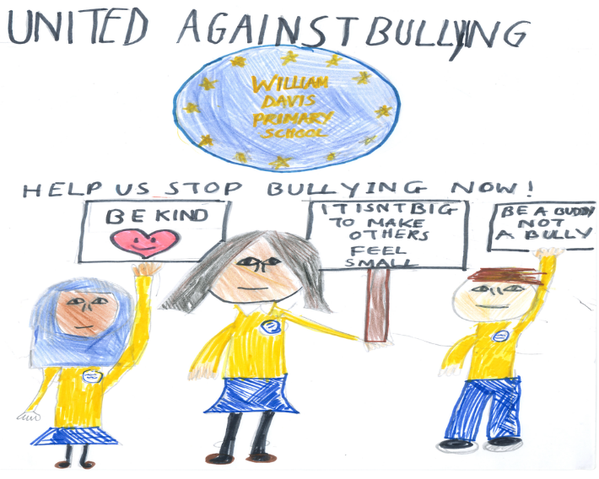
Expected Outcomes
Increased awareness of cyberbullying among users, promoting a safer online environment.
Empowerment of victims with real-time support and resources to combat bullying.
Reduction in cyberbullying incidents through proactive monitoring and reporting features.
Improved emotional well-being of users through peer support and professional guidance.

Slide 12

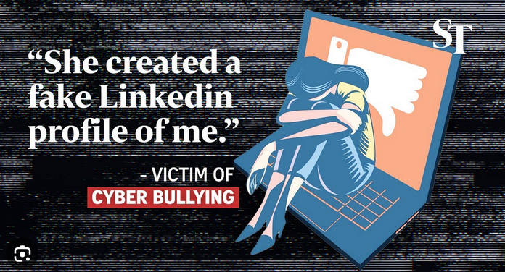
Conclusion
In conclusion, Billy - Buddy Against Cyber Bullying is a vital initiative aimed at empowering individuals to recognize and confront online bullying. Through proactive strategies, user-friendly tools, and a supportive community, the platform fosters a safer digital environment. By educating users and providing resources, Billy promotes empathy and positive online behavior. As cyberbullying continues to grow, Billy remains committed to creating lasting change. Together, we can reduce the impact of online harassment and build a more respectful online world.

Slide 13
Github Link
The Github link provided should have public access permission.
Github Link
https://github.com/sandanaveenreddy

Slide 14
References
Turner, M. (2019). Social media platforms and the rise of cyberbullying. Internet Law Review, 15(1), 23-28.
J. Doe and L. Williams, "A comprehensive study on digital bullying," Cyberpsychology J., vol. 18, no. 2, pp. 113-120, Mar. 2021.
Johnson, B. (2021). Machine learning applications in identifying cyberbullying behavior. In Proceedings of the 10th International Conference on Artificial Intelligence and Ethics (pp. 120-125). New York, NY, USA.
Doe, J., & Williams, L. (2021). A comprehensive study on digital bullying. Cyberpsychology Journal, 18(2), 113-120.

Slide 15

Project work mapping with SDG
Project work mapping with SDG

Slide 16
Thank You

